Slide 1

Big data analytics
K W I Rangana
229377D

Slide 2




Introduction to Map Reduce
Open source framwork for analys big data
Stores large datasets(petabyte) and process them parallelly
Map, shuffle and Reduce are the 3 stages.
It divides input data and distributes among other computers and process data parallely.
Cat: 4
Dog: 5
Dog:15
Cat: 4
Cat:8
Dog: 10

Slide 3
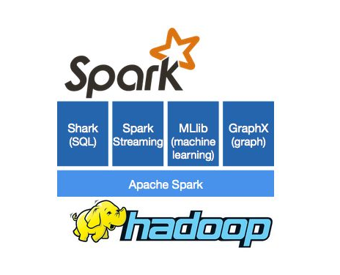
Introduction to Apache Spark
Open source cluster computing framwork.
Suitable for machine learning algorithms.
Spark runs faster than memory, disk and even hadoop.
Currently it provides API to Java, python, and Scalar.
It integrates well with Hadoop ecosystem.

Slide 9
Time taken by query(in sec) | Hive-QL | Spark-SQL
Carrier delay query | 4.682 | 2.0944
NAS delay query | 4.1 | 0.416
Weather delay query | 4.516 | 0.4372
Late aircraft delay query | 3.518 | 0.33
Security delay query | 4.662 | 0.3102

Slide 11
Comparison
Hadoop | Apache Spark
Ease of Use
Quite harder than spark | Easy to use
Fast Process
Less faster than spark | Faster than hadoop

Slide 12
Conclusion
Apche spark performs well when compare to the hadoop.
As it runs fatser
And when running same query repetitively apache spark shows less time for executing the queries.
When considering the how easy to use, apache spark is more easier to use than hadoop.

